Slide 1


The Data Science Landscape
01
PART I · FOUNDATIONS OF DATA
CHAPTER 1 · WEEK 1
Data Science — From Foundations to Intelligent Systems
LECTURER
Dr. Mustafa Hameed
THE ISLAMIA UNIVERSITY OF BAHAWALPUR
Bahawalpur, Pakistan
Department of Information Technology · BSIT · Fall 2026
Notes:
Chapter 1: The Data Science Landscape. Part 1 — Foundations of Data. Week 1: The landscape and the lifecycle. Handout pages 3–10.

Slide 2

Where this chapter sits
THE COURSE
PART I
PART II
PART III
PART IV
PART V
PART VI
1
2
3
4
5
6
7
8
9
10
11
12
13
14
15
16
17
18
19
20
21
22
23
24
25
26
27
28
29
30
31
32
The Data Science Landscape
BUILDS ON
USED LATER IN
— nothing earlier in the course
Ch 2 The Data Science Lifecycle
Data Science · Chapter 1 · The Data Science Landscape
Handout p. 3 2
Notes:
Place the chapter. Before you start: None. This is the entry point of the course. If the prerequisite self-check in the front matter gave you trouble, keep Appendix C beside you.

Slide 3

What you will be able to do
LEARNING OUTCOMES
By the end of this chapter you will be able to:
1
Define data science and distinguish it from artificial intelligence, machine learning, deep learning, generative AI and agentic AI.
2
Explain why these fields are nested rather than separate, using the containment diagram.
3
Classify a problem into the level of analytics it requires — descriptive, diagnostic, predictive or prescriptive.
4
Identify the main roles on a data team and what each is accountable for.
5
Describe one realistic data science application in each of the four running domains of this course.
Data Science · Chapter 1 · The Data Science Landscape
Handout p. 3 3
Notes:
Read these out: they are the chapter's contract with the room. Each click adds one.

Slide 4

Vocabulary for this chapter
KEY TERMS
data science
artificial intelligence
machine learning
deep learning
generative AI
agentic AI
data mining
descriptive, diagnostic, predictive and prescriptive analytics
data product
Each term is defined where it first matters — not here.
Data Science · Chapter 1 · The Data Science Landscape
Handout p. 3 4
Notes:
Do not define these now; they arrive one at a time. This slide is for the students' notes. Terms: data science; artificial intelligence; machine learning; deep learning; generative AI; agentic AI; data mining; descriptive, diagnostic, predictive and prescriptive analytics; data product.

Slide 5

In this chapter
IN THIS CHAPTER
1.1
A Motivating Scenario
p. 3 ›
1.2
What Data Science Is
p. 4 ›
1.3
The Nested Fields: AI, ML and Deep Learning
p. 4 ›
1.4
The Newer Members: Generative and Agentic AI
p. 5 ›
1.5
The Four Levels of Analytics
p. 6 ›
1.6
Who Does What: Roles on a Data Team
p. 7 ›
Data Science · Chapter 1 · The Data Science Landscape
Handout pp. 3–10 5
Notes:
The route through the chapter. Each row is a link: click it to jump to that section in the slide show.

Slide 6
A Motivating Scenario
IN BRIEF
Three different questions could be asked of that pile of data, and they are not the same question:
• How many students failed last year, and in which week did they stop submitting? — a question about what happened.
• Which students currently enrolled are likely to fail? — a question about what will happen.
• Which of these students should get a tutor, given that we can only fund fifteen? — a question about what to do.
Data Science · Chapter 1 · The Data Science Landscape
§1.1 · Handout p. 3 6
Notes:
A university notices that roughly one student in five fails the first-year programming course. The department has years of records: enrolment forms, weekly attendance, submission timestamps from the online judge, forum posts, quiz scores. Nobody has ever looked at them together.

Slide 7
What Data Science Is
SECTION 2 OF 6
1.2
1.1 A Motivating Scenario
1.2 What Data Science Is
1.3 The Nested Fields: AI, ML and Deep Learning
1.4 The Newer Members: Generative and Agentic AI
1.5 The Four Levels of Analytics
1.6 Who Does What: Roles on a Data Team
Data Science · Chapter 1
Handout §1.2 7
Notes:
Pause. Name the question this section answers.

Slide 8

Data Science
DEFINITION
Data science is the interdisciplinary practice of turning data into understanding and action. It combines statistics, computing, data engineering, machine learning, domain knowledge and communication to extract insight, build predictive systems and support better decisions.
Data Science · Chapter 1 · The Data Science Landscape
§1.2 · Handout p. 4 8
Notes:
Data science is the discipline that answers all three, and that knows the difference between them.

Slide 9

The Three Things Data Science Needs at Once
CONCEPT
Mathematics and statistics without programming leaves you unable to work at scale. Programming without statistics produces confident nonsense. Both without domain knowledge produce technically correct answers to the wrong question. Most failures you will meet in industry are of the third kind.
Data Science · Chapter 1 · The Data Science Landscape
§1.2 · Handout p. 4 9
Notes:
The definition is deliberately broad because the work is broad. Notice what it contains besides mathematics: domain knowledge, because a model of student failure built by someone who has never taught will be wrong in ways nobody catches; and communication, because an insight nobody acts on has accomplished nothing.

Slide 10
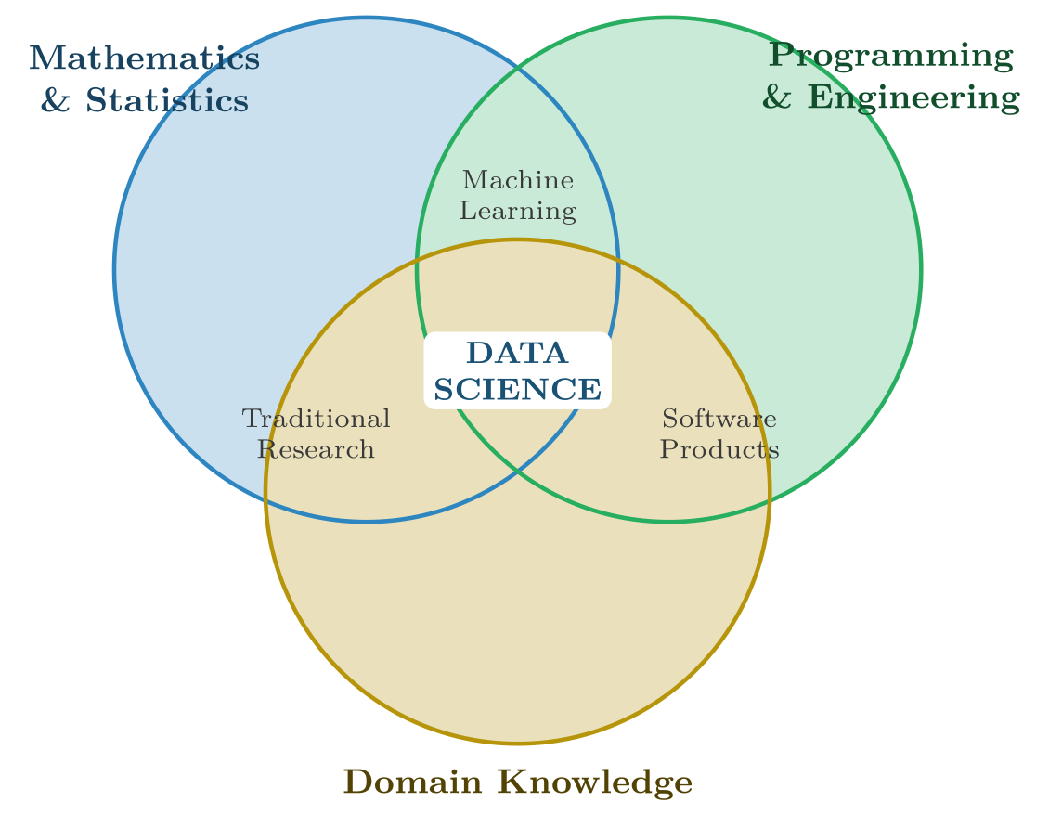
Data science as the intersection of three capabilities
FIGURE 1.1
Each pair produces something useful on its own; only the centre is data science. The most common professional failure is drifting out of the gold circle — solving a problem the domain did not have.
Data Science · Chapter 1 · The Data Science Landscape
§1.2 · Handout p. 4 10
Notes:
Figure 1.1 (handout p. 4): Data science as the intersection of three capabilities. Each pair produces something useful on its own; only the centre is data science. The most common professional failure is drifting out of the gold circle — solving a problem the domain did not have.

Slide 11
The Nested Fields: AI, ML and Deep Learning
SECTION 3 OF 6
1.3
1.1 A Motivating Scenario
1.2 What Data Science Is
1.3 The Nested Fields: AI, ML and Deep Learning
1.4 The Newer Members: Generative and Agentic AI
1.5 The Four Levels of Analytics
1.6 Who Does What: Roles on a Data Team
Data Science · Chapter 1
Handout §1.3 11
Notes:
Pause. Name the question this section answers.

Slide 12
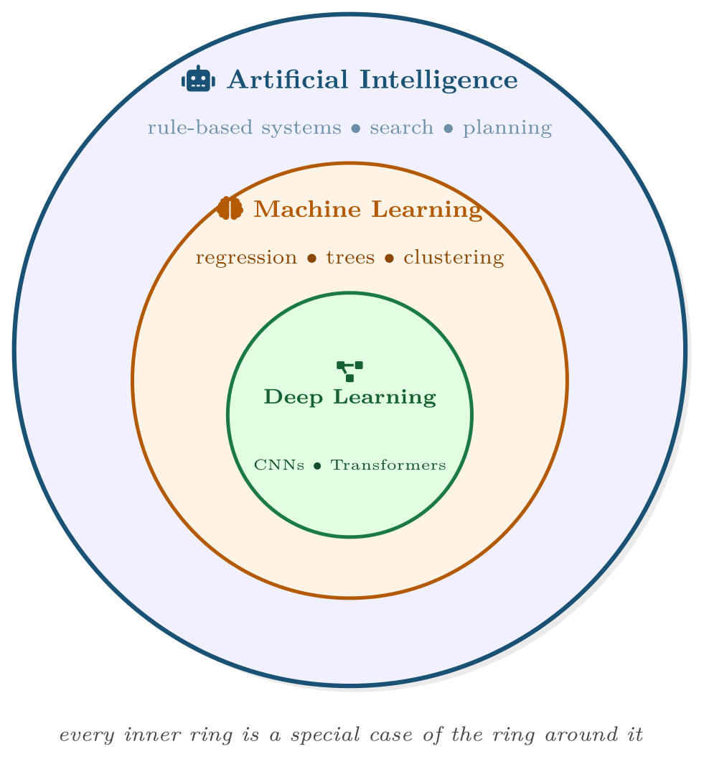
The nesting of AI, machine learning and deep learning
FIGURE 1.2
Every deep learning system is a machine learning system; every machine learning system is an AI system; the reverse is false in both cases. A hand-written rulebook that decides loan applications is AI but not machine learning.
Data Science · Chapter 1 · The Data Science Landscape
§1.3 · Handout p. 4 12
Notes:
Students routinely use “AI”, “machine learning” and “deep learning” as synonyms. They are not synonyms; they are nested. Getting this right in the first week saves confusion for the rest of the course.
Figure 1.2 (handout p. 5): The nesting of AI, machine learning and deep learning. Every deep learning system is a machine learning system; every machine learning system is an AI system; the reverse is false in both cases. A hand-written rulebook that decides loan applications is AI but not machine learning.

Slide 13
The Nested Fields: AI, ML and Deep Learning
IN BRIEF
• Artificial Intelligence is the outermost field: any technique that makes a machine behave in a way we would call intelligent. A chess program that searches moves exhaustively is AI and contains no learning at all.
• Machine Learning is the subset of AI in which behaviour is learned from data rather than programmed. Nobody writes the rule “if the email contains the word lottery, mark it spam” — the algorithm discovers it.
• Deep Learning is the subset of ML that uses neural networks with many layers, which lets the system learn its own features instead of being handed them.
Data Science · Chapter 1 · The Data Science Landscape
§1.3 · Handout p. 4 13
Notes:
Read the box aloud, then ask for an example from the room before moving on.

Slide 14
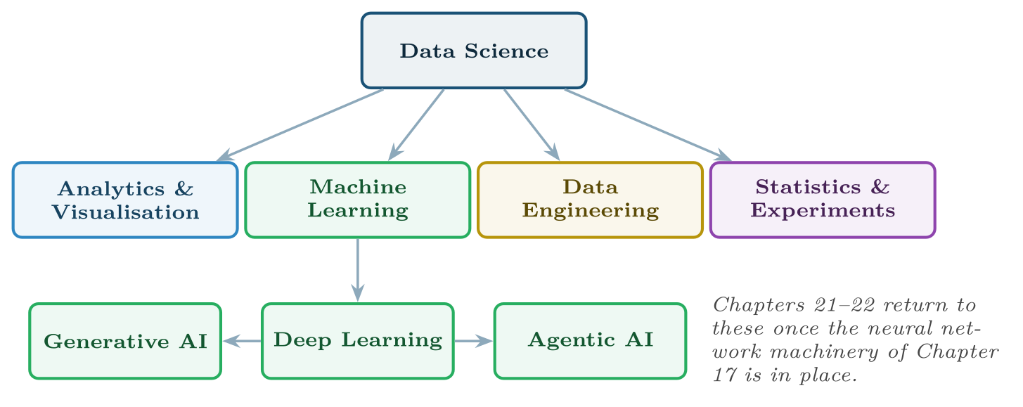
Data science and its component practices
FIGURE 1.3
Analytics, engineering and statistics are first-class members, not lesser cousins of machine learning — most working days involve more of them than of modelling.
Data Science · Chapter 1 · The Data Science Landscape
§1.3.1 · Handout p. 5 14
Notes:
Data science is not a fourth ring inside those circles — it overlaps them. Plenty of valuable data science involves no machine learning at all: a well-built dashboard showing a hospital its live bed occupancy changes decisions every day and contains not one model.
Figure 1.3 (handout p. 5): Data science and its component practices. Analytics, engineering and statistics are first-class members, not lesser cousins of machine learning — most working days involve more of them than of modelling.

Slide 15
The Newer Members: Generative and Agentic AI
SECTION 4 OF 6
1.4
1.1 A Motivating Scenario
1.2 What Data Science Is
1.3 The Nested Fields: AI, ML and Deep Learning
1.4 The Newer Members: Generative and Agentic AI
1.5 The Four Levels of Analytics
1.6 Who Does What: Roles on a Data Team
Data Science · Chapter 1
Handout §1.4 15
Notes:
Pause. Name the question this section answers.

Slide 16
Generative AI
DEFINITION
Systems that create new content — text, images, code, audio — resembling their training data, rather than producing a label or a number. The question they answer is “what would plausibly come next?”
Data Science · Chapter 1 · The Data Science Landscape
§1.4 · Handout p. 5 16
Notes:
Two terms have entered everyday use recently and are worth pinning down now, even though the course does not treat them properly until Part IV.

Slide 17
Agentic AI
DEFINITION
Systems that pursue a goal over multiple steps: they plan, call tools, observe results and adapt. The question they answer is “what should I do next to get this done?”
Data Science · Chapter 1 · The Data Science Landscape
§1.4 · Handout p. 5 17
Notes:
Read the box aloud, then ask for an example from the room before moving on.

Slide 18
Predictive, Generative, Agentic in One Sentence Each
CONCEPT
A predictive model tells you a student is likely to fail. A generative model drafts the email you send them. An agentic system checks the timetable, finds a free tutor slot, drafts the email, books the appointment and reports back. Each is strictly more capable — and strictly harder to keep under control.
Data Science · Chapter 1 · The Data Science Landscape
§1.4 · Handout p. 5 18
Notes:
Read the box aloud, then ask for an example from the room before moving on.

Slide 19
The Four Levels of Analytics
SECTION 5 OF 6
1.5
1.1 A Motivating Scenario
1.2 What Data Science Is
1.3 The Nested Fields: AI, ML and Deep Learning
1.4 The Newer Members: Generative and Agentic AI
1.5 The Four Levels of Analytics
1.6 Who Does What: Roles on a Data Team
Data Science · Chapter 1
Handout §1.5 19
Notes:
Pause. Name the question this section answers.

Slide 20
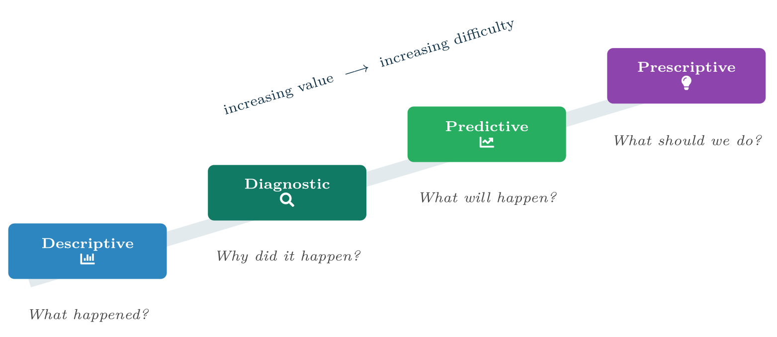
The four levels of analytics
FIGURE 1.4
Value rises as you climb, but so does the cost of being wrong: a mistaken description misleads, a mistaken prescription causes harm.
Data Science · Chapter 1 · The Data Science Landscape
§1.5 · Handout p. 6 20
Notes:
The three questions in the opening scenario were not arbitrary. They correspond to a standard ladder of analytical maturity, and one of the most useful things you can do at the start of any project is work out which rung you are actually on.
Figure 1.4 (handout p. 6): The four levels of analytics. Value rises as you climb, but so does the cost of being wrong: a mistaken description misleads, a mistaken prescription causes harm.

Slide 21

The Four Levels of Analytics
AT A GLANCE
Level | Typical technique | Example from the opening scenario
Descriptive | Counts, averages, dashboards, visualisation | 21% of students failed; submissions collapse in week 6
Diagnostic | Segmentation, correlation, drill-down, root cause | Failures concentrate among students who missed the week 5 lab
Predictive | Classification, regression, forecasting | This student has an estimated 0.78 probability of failing
Prescriptive | Optimisation, simulation, decision rules | Assign the fifteen tutor slots so as to maximise expected passes
Data Science · Chapter 1 · The Data Science Landscape
§1.5 · Handout p. 6 21
Notes:
Do not read the table row by row: pick the row the room is most likely to get wrong and ask why.

Slide 22

Common pitfalls
COMMON PITFALLS
✕
Selling prescriptive, delivering descriptive. The most common failure of student and industry projects alike. Be honest about which rung you reached.
✕
Skipping straight to prediction. If nobody has described the data yet, your model rests on a misunderstanding. Every hour spent on Chapter 8 saves three in Chapter 14.
✕
Assuming prescription follows from prediction. Knowing who will fail does not tell you what helps. That needs the causal thinking of Chapter 10.
Data Science · Chapter 1 · The Data Science Landscape
§1.5 · Handout p. 6 22
Notes:
For each pitfall, ask who has seen it happen. One real story beats five bullets.

Slide 23
Who Does What: Roles on a Data Team
SECTION 6 OF 6
1.6
1.1 A Motivating Scenario
1.2 What Data Science Is
1.3 The Nested Fields: AI, ML and Deep Learning
1.4 The Newer Members: Generative and Agentic AI
1.5 The Four Levels of Analytics
1.6 Who Does What: Roles on a Data Team
Data Science · Chapter 1
Handout §1.6 23
Notes:
Pause. Name the question this section answers.

Slide 24
Who Does What: Roles on a Data Team
AT A GLANCE
Role | Accountable for | Chapters that matter most
Data Analyst | Describing and diagnosing; dashboards and reports decision-makers actually use | 7, 8, 9, 31
Data Scientist | Framing problems, building and validating models, quantifying uncertainty | 9–16, 28
Data Engineer | Reliable pipelines; data arriving complete, on time and in the right shape | 3, 7, 23, 24
ML Engineer | Getting models into production and keeping them correct there | 17–19, 27
Security Analyst | Detecting and investigating threats in system and network data | 14, 16, 19, 26
IoT / Edge Engineer | Sensor fleets, telemetry pipelines, on-device inference | 19, 24, 25
Product / Project Manager | Choosing what is worth building, and delivering it | 2, 30, 31
Data Science · Chapter 1 · The Data Science Landscape
§1.6 · Handout p. 7 24
Notes:
Do not read the table row by row: pick the row the room is most likely to get wrong and ask why.

Slide 25
These Are Roles, Not People
CONCEPT
In a large organisation these are seven job titles. In a small one they are seven hats worn by two people, and in your final-year project they will all be worn by you. That is precisely why this handout covers all of them.
Data Science · Chapter 1 · The Data Science Landscape
§1.6 · Handout p. 7 25
Notes:
Read the box aloud, then ask for an example from the room before moving on.

Slide 26





Four lenses: The Levels of Analytics
FOUR LENSES
LEARNING ANALYTICS
PROJECT MANAGEMENT
A university wants to reduce first-year attrition.
A software house delivers projects late about half the time.
INTERNET OF THINGS
CYBERSECURITY
A factory runs 400 motors instrumented for vibration and temperature.
A bank monitors authentication logs across 12,000 accounts.
Data Science · Chapter 1 · The Data Science Landscape
Handout p. 10 26
Notes:
The same method, four domains. Each of the next four slides opens one lens in full.

Slide 27

Learning Analytics: The Levels of Analytics
FOUR LENSES
LEARNING ANALYTICS
Project Management
A university wants to reduce first-year attrition. Descriptive: dashboards of attendance and submission rates by cohort. Diagnostic: which combinations of missed activities precede withdrawal. Predictive: a weekly risk score per student. Prescriptive: an allocation of limited tutoring hours to the students it will help most. Only the first rung is reachable without the rest of this book — and only the first is safe to deploy without reading Chapter 28.
Internet of Things
Cybersecurity
Data Science · Chapter 1 · The Data Science Landscape
Handout p. 10 27
Notes:
Learning Analytics. A university wants to reduce first-year attrition. Descriptive: dashboards of attendance and submission rates by cohort. Diagnostic: which combinations of missed activities precede withdrawal. Predictive: a weekly risk score per student. Prescriptive: an allocation of limited tutoring hours to the students it will help most. Only the first rung is reachable without the rest of this book — and only the first is safe to deploy without reading Chapter 28.

Slide 28

Project Management: The Levels of Analytics
FOUR LENSES
PROJECT MANAGEMENT
Learning Analytics
A software house delivers projects late about half the time. Descriptive: historical burn-down and estimate-versus-actual charts. Diagnostic: which task types are systematically underestimated. Predictive: a sprint-completion forecast published each Wednesday. Prescriptive: a recommended re-allocation of two developers. The predictive rung is where project management stops being reporting and becomes data science.
Internet of Things
Cybersecurity
Data Science · Chapter 1 · The Data Science Landscape
Handout p. 10 28
Notes:
Project Management. A software house delivers projects late about half the time. Descriptive: historical burn-down and estimate-versus-actual charts. Diagnostic: which task types are systematically underestimated. Predictive: a sprint-completion forecast published each Wednesday. Prescriptive: a recommended re-allocation of two developers. The predictive rung is where project management stops being reporting and becomes data science.

Slide 29

Internet of Things: The Levels of Analytics
FOUR LENSES
INTERNET OF THINGS
Learning Analytics
A factory runs 400 motors instrumented for vibration and temperature. Descriptive: live telemetry dashboards. Diagnostic: which sensor pattern preceded last quarter’s three failures. Predictive: remaining useful life per motor. Prescriptive: a maintenance schedule minimising downtime cost. Because data arrives continuously and in volume, even the descriptive rung needs the engineering of Chapter 23.
Project Management
Cybersecurity
Data Science · Chapter 1 · The Data Science Landscape
Handout p. 10 29
Notes:
Internet of Things. A factory runs 400 motors instrumented for vibration and temperature. Descriptive: live telemetry dashboards. Diagnostic: which sensor pattern preceded last quarter’s three failures. Predictive: remaining useful life per motor. Prescriptive: a maintenance schedule minimising downtime cost. Because data arrives continuously and in volume, even the descriptive rung needs the engineering of Chapter 23.

Slide 30

Cybersecurity: The Levels of Analytics
FOUR LENSES
CYBERSECURITY
Learning Analytics
A bank monitors authentication logs across 12,000 accounts. Descriptive: failed-login counts by region and hour. Diagnostic: which accounts share an unusual user-agent string. Predictive: a per-session compromise likelihood. Prescriptive: automatic step-up authentication for the riskiest 0.1% of sessions. Here an adversary is actively trying to look normal, which is what makes the security lens harder than the other three.
Project Management
Internet of Things
Data Science · Chapter 1 · The Data Science Landscape
Handout p. 10 30
Notes:
Cybersecurity. A bank monitors authentication logs across 12,000 accounts. Descriptive: failed-login counts by region and hour. Diagnostic: which accounts share an unusual user-agent string. Predictive: a per-session compromise likelihood. Prescriptive: automatic step-up authentication for the riskiest 0.1% of sessions. Here an adversary is actively trying to look normal, which is what makes the security lens harder than the other three.

Slide 31

Classifying a Request
WORKED EXAMPLE
A programme director asks: “Can you tell me whether the new lab format is worth keeping?” Which rung is really being requested?
Step 1 — restate it as something measurable. “Worth keeping” must become countable. Say: does the new lab format raise the end-of-semester pass rate?
Step 2 — identify the rung. It is not descriptive (pass rates alone would not settle it) and not predictive (nobody is asking about a future student). It is diagnostic, and specifically causal: did the format cause the change?
Step 3 — name what that requires. A causal claim needs a comparison group and a design that rules out rival explanations — the machinery of Chapter 10. Comparing this year’s pass rate with last year’s confounds the format with a different cohort, different staff and a different exam paper.
Answer: the request is a causal question disguised as a descriptive one. Delivering a bar chart of pass rates would answer the wrong question convincingly, which is worse than answering nothing.
Data Science · Chapter 1 · The Data Science Landscape
§1.6 · Handout p. 7 31
Notes:
Each click adds one step of the working. Ask for the next number before you reveal it.

Slide 32

Try it yourself: Meeting a Dataset
TRY IT YOURSELF
The two most important facts about any new dataset are its shape and its types. Every project in this course starts here.
THIS WEEK'S LAB
WHAT YOU WILL RUN
Week 1: Meet a dataset; write a frame
1 listing, 14 lines of Python
Data Science · Chapter 1 · The Data Science Landscape
§1.6 · Handout p. 7 32
Notes:
The two most important facts about any new dataset are its shape and its types. Every project in this course starts here.

Slide 33
Meeting a Dataset
LAB · STEP 1 OF 1
Set-up
Python
1
2
3
4
5
6
7
8
9
10
11
12
13
14
import pandas as pd
# A tiny extract of the kind of record a learning analytics project starts from.
df = pd.DataFrame({
"student_id": [101, 102, 103, 104, 105],
"attendance_pct": [92, 45, 78, 30, 88],
"quizzes_done": [8, 3, 6, 2, 8],
"forum_posts": [12, 0, 4, 1, 20],
"final_grade": ["A", "F", "C", "F", "A"],
})
print(df.shape) # (rows, columns) -> 5 observations, 5 features
print(df.dtypes) # what type is each column?
print(df.describe()) # centre and spread of the numeric columns
Data Science · Chapter 1 · The Data Science Landscape
§1.6 · Handout p. 7 33
Notes:
Step 1: Set-up. Read the code aloud; ask what each line would print before running it.

Slide 34
What the lab shows
TRY IT YOURSELF
Then answer, without fitting anything: which columns look related to final_grade? That informal glance is descriptive analytics, and it is where every project should begin.
Data Science · Chapter 1 · The Data Science Landscape
§1.6 · Handout p. 7 34
Notes:
Read the box aloud, then ask for an example from the room before moving on.

Slide 35

A hospital deploys a hand-written rulebook: “if temperature >39°C and white cell count is high, flag for review.” Is this AI? Is it machine learning? Justify both answers.
CHECKPOINT 1 OF 3
Discuss with the person next to you, then advance.
Data Science · Chapter 1 · The Data Science Landscape
Handout p. 10 · answers in Appendix D 35
Notes:
Ask the room. Do not advance until someone commits to an answer.

Slide 36

A hospital deploys a hand-written rulebook: “if temperature >39°C and white cell count is high, flag for review.” Is this AI? Is it machine learning? Justify both answers.
CHECKPOINT 1 OF 3 · ANSWER
It is AI — it performs a task that would otherwise need human clinical judgement. It is not machine learning, because the rule was written by a person rather than learned from data. This is the distinction Figure 1.2 makes.
Data Science · Chapter 1 · The Data Science Landscape
Handout p. 10 · answers in Appendix D 36
Notes:
Answer (Appendix D): It is AI — it performs a task that would otherwise need human clinical judgement. It is not machine learning, because the rule was written by a person rather than learned from data. This is the distinction Figure 1.2 makes.

Slide 37
Classify each request by analytics level: (a) “How many tickets did we close last month?” (b) “Which server will run out of disk first?” (c) “Why did response times spike on Tuesday?” (d) “What is the cheapest way to meet our uptime target?”
CHECKPOINT 2 OF 3
Discuss with the person next to you, then advance.
Data Science · Chapter 1 · The Data Science Landscape
Handout p. 10 · answers in Appendix D 37
Notes:
Ask the room. Do not advance until someone commits to an answer.

Slide 38
Classify each request by analytics level: (a) “How many tickets did we close last month?” (b) “Which server will run out of disk first?” (c) “Why did response times spike on Tuesday?” (d) “What is the cheapest way to meet our uptime target?”
CHECKPOINT 2 OF 3 · ANSWER
(a) descriptive; (b) predictive; (c) diagnostic; (d) prescriptive.
Data Science · Chapter 1 · The Data Science Landscape
Handout p. 10 · answers in Appendix D 38
Notes:
Answer (Appendix D): (a) descriptive; (b) predictive; (c) diagnostic; (d) prescriptive.

Slide 39
A colleague says “we’re doing AI” about a dashboard of monthly sales totals. What are they actually doing, and why does the distinction matter to whoever is paying for it?
CHECKPOINT 3 OF 3
Discuss with the person next to you, then advance.
Data Science · Chapter 1 · The Data Science Landscape
Handout p. 10 · answers in Appendix D 39
Notes:
Ask the room. Do not advance until someone commits to an answer.

Slide 40
A colleague says “we’re doing AI” about a dashboard of monthly sales totals. What are they actually doing, and why does the distinction matter to whoever is paying for it?
CHECKPOINT 3 OF 3 · ANSWER
They are doing descriptive analytics. The distinction matters to whoever is paying because descriptive work is cheaper, faster and lower-risk than the predictive system the word “AI” implies — and because expectations set at the wrong rung cause the project to be judged a failure for delivering exactly what was needed.
Data Science · Chapter 1 · The Data Science Landscape
Handout p. 10 · answers in Appendix D 40
Notes:
Answer (Appendix D): They are doing descriptive analytics. The distinction matters to whoever is paying because descriptive work is cheaper, faster and lower-risk than the predictive system the word “AI” implies — and because expectations set at the wrong rung cause the project to be judged a failure for delivering exactly what was needed.

Slide 41

What to take away
CHAPTER SUMMARY
1
Data science turns data into understanding and action; it needs mathematics, programming and domain knowledge simultaneously.
2
AI ⊃ machine learning ⊃ deep learning. The containment is strict in both directions of the argument: not all AI learns, and not all learning is deep.
3
Generative AI creates content; agentic AI pursues goals over multiple steps. Both build on the deep learning of Part IV.
4
Analytics has four rungs — descriptive, diagnostic, predictive, prescriptive. Value and risk both increase as you climb.
5
Much valuable data science contains no model at all. Do not mistake modelling for the whole discipline.
Data Science · Chapter 1 · The Data Science Landscape
Handout p. 10 41
Notes:
Ask the room to say each takeaway before you reveal it.

Slide 42

Quick check 1 of 2
REVIEW · MULTIPLE CHOICE
Which statement is true?
A
All machine learning is deep learning
B
All deep learning is machine learning
AI and machine learning are the same field
Data science is a subset of deep learning
C
D
Data Science · Chapter 1 · The Data Science Landscape
Handout p. 10 42
Notes:
Take a show of hands for each option before discussing. (The handout does not print MCQ answers.)

Slide 43
Quick check 2 of 2
REVIEW · MULTIPLE CHOICE
A model estimates the probability that a motor fails within 30 days. This is:
A
descriptive
B
diagnostic
C
predictive
D
prescriptive
Data Science · Chapter 1 · The Data Science Landscape
Handout p. 10 43
Notes:
Take a show of hands for each option before discussing. (The handout does not print MCQ answers.)

Slide 44
For your notebook
REVIEW QUESTIONS
SHORT
Give one example of an AI system that contains no machine learning, and explain what makes it AI nonetheless.
SHORT
Explain, in two sentences, the difference between a generative and an agentic system.
SHORT
Why is domain knowledge treated in this chapter as a capability equal to statistics and programming rather than as background?
APPLIED
A retailer asks you to “use AI to increase sales.” Rewrite this as one question at each of the four analytics levels, and state which you would deliver first and why.
APPLIED
For each of the four running domains of this course, name one descriptive question and one predictive question that a first-year BSIT student could realistically attempt.
Data Science · Chapter 1 · The Data Science Landscape
Handout p. 10 44
Notes:
Set these for independent study. Model answers are not printed in the handout.

Slide 45
End of Chapter 1
01
NEXT
READ
Chapter 2 — The Data Science Lifecycle
Handout Chapter 1, pages 3–10
THIS WEEK'S LAB
Meet a dataset; write a frame
Data Science · Chapter 1 · The Data Science Landscape
45
Notes:
Close. NEXT: Chapter 2 — The Data Science Lifecycle. READ: Handout Chapter 1, pages 3–10. THIS WEEK'S LAB: Meet a dataset; write a frame.

